Slide 1
Material requirement planning (MRP)
Chapter 5
TexPoint fonts used in EMF.
Read the TexPoint manual before you delete this box.: AAAAAAA
Notes:
during the past two decandes many industrial companies changed their inventory systems -> from reorder point systems (independent-demand system) to MRP systems (dependend-demand systems). approach was developed in early 70s
appropriate for considering complex products, assembled of various components and subassemblies
major objective: determine requirements (discrete demand for each component in each time bucket) -> used to generate infomration required for correct material purchasing or shop-floor production

Slide 2
Production, Capacity and Material Planning
Updates
Detailed Capacity Planning
Rough-Cut Capacity
Material Plan
Purchasing Plan
Master Production Schedule (MPS)
Material Requirements Planning (MRP)
End-Item Demand Estimate
Shop Floor Control
Shop Orders
Updates

Slide 3
Material Requirements Planning
What is MRP?
translate end-item requirements
generate time-phased requirements for components & raw materials
Input
master production schedule (MPS) … planning data
inventory status records
bill of material (BOM) / product structure … master data
Output
planned order releases
purchase orders (supply lead time)
work orders (manufacturing lead time)

Slide 4
Material Requirements Planning
MRP Process
Explosion
stimulate disassembly of endproduct in its components (BOM)
returns gross requirements
Netting
adjust gross requirements for inventory
net requirement = max(0, gross requirements – inventory – scheduled receipts)
Offsetting
determine order release (lead time!)
Lotsizing: determine batch size

Slide 5
MRP Example
Level 0
End-Item
1
Legend:
S/A = subassembly
PP = purchased part
MP = manufactured part
RM = raw material
Level 1
S/A
2
1
Level 2
PP
5
S/A
6
4
2
Level 3
MP
PP
part #
9
10
1
quantity
2
Level 4
RM
12
RM
13
4
2

Slide 6
Example Telephone (BOM) Example 7-6
Telephone
1
Hand Set Assembly
11
Base Assembly
12
Hand Set Cord
13
1
1
1
Microphone S/A
111
Housing S/A
121
Rubber Pad
Board Pack S/A
122
123
1
1
Tapping Screw
Tapping Screw
115
124
112
1
4
Receiver S/A
2
4
1
Upper Cover
Lower Cover
Key Pad
Key Pad Cord
113
114
1211
1212
1
1
1
1

Slide 7
Example Telephone
MPS for phone (final product)
no on hand inventory
MPS = gross requirements for components
 | Week
 | 1 | 2 | 3 | 4 | 5 | 6 | 7 | 8
MPS |  | 600 | 1000 | 1000 | 2000 | 2000 | 2000 | 2000

Slide 8
MRP – example (part 11)
lead time = 2 weeks, initial inventory = 1200, batch size = 3000
NR₁ = max(0, 0-1600) = 0 PIB₁ = 1200 + 400 - 0 = 1600
NR₂ = max(0, 600-(1600+700)) = 0
PIB₂ = 1600 + 700 – 600 = 1700
 | current | 1 | 2 | 3 | 4 | 5 | 6 | 7 | 8
gross requirements |  |  | 600 | 1000 | 1000 | 2000 | 2000 | 2000 | 2000
scheduled receipts |  | 400 | 700 | 200
projected inventory balance | 1200 | 1600 | 1700 | 900 | 2900 | 900 | 1900 | 2900 | 900
net requirements |  | 0 | 0 | 0 | 100 | 0 | 1100 | 100 | 0
planned receipts |  | 0 | 0 | 0 | 3000 | 0 | 3000 | 3000 | 0
planned order release |  |  | 3000 |  | 3000 | 3000

Slide 9
MRP – example (cont)
Multilevel explosion
lead time is one week for all parts
lot for lot for parts 121, 123, 1211 (produce/order net requirement)
part 12: fixed lot size of 3000

Slide 10
x1
x1
x1
x4
x4
x4
x1
x1
x1

Slide 11
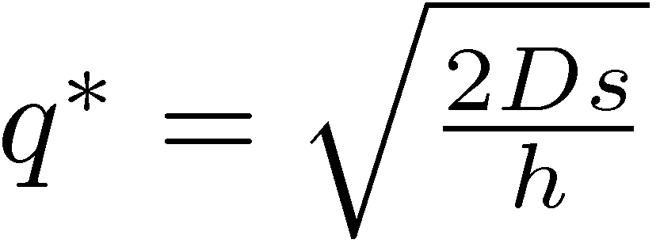
Lotsizing
Basic lot sizing model: EOQ (Economic Order Quantity)
single product
ordered quantity q
non-fluctuating demand D
fixed setup costs s
inventory holding charge h
goal: optimize tradeoff
(average) inventory holding costs + setup costs per period

Slide 12
Inventory in the EOQ model
inventory
„sawtoothed“ inventory
Order quantity q
= max inventory
demand
maximum inventory q
demand D slope -D
1
-D
average inventory q/2
min inventory
Production Lot q
Production Lot q
Production Lot q
time

Slide 13
Lotsizing in MRP
more difficult
multiple items
multiple levels (product structure!)
goal
find set of lots such that total costs (whole system!) will be minimized
simplest approach
use several single-level lotsizing models
solve level by level
descend through product structure diagram
common in industry
model & solve MIP
solve heuristically

Slide 14
MIP Formulation for MRP
notation
P number of products (i=1..P)
T length of planning horizon (t = 1..T)
M number of machines/resources (m = 1..M)
decision variables
x_{it} delivered quantity of item i in period t
I_{it} inventory level of item i at the end of period t
O_{mt} overtime hours required for machine m in period t
y_{it} binary variable indicating if item i is produced in period t (=1) or not (=0)

Slide 15
MIP Formulation for MRP
Parameters
D_{it} external demand of item i in period t
Γ(i) set of immediate successors of item i (BOM)
Γ⁻¹⁽i) set of immediate predeccessors of item i
c_{ij} quantity of item i required to produce item j
C^{S}_{i} setup cost for item i
C^{H}_{i} holding cost for one unit of item i
C^{O}_{m} overtime cost of resource m
a_{mi} capacity needed on resource m for one unit of item i
b_{mi} capacity needed on resource m for the setup process of item i
L_{mt} available capacity of resource m in period t
M large number, but as small as possible (e.g. sum of demands)

Slide 16
MIP Formulation for MRP
objective function
minimize costs (setup + inventory + overtime)
constraints
inventory balance
link to binary indicator (big M) -> setup costs
capacity
non-negativity
binary y_{it} ∈{0, 1}

Slide 17
Example MIP
3 Products, 4 periods, 1 machine
P = 3 T = 4 M = 1
successors Γ (1) = {3}, Γ(2) = {1,3} Γ(3) = {}
production coefficients c₂₁ = 1 c₂₃ =2 c₁₃=1

