Slide 1
Aggregate Planning
(from Course Production Analysis)
Advanced Production Planning Models

Slide 2
Extensions
multiple products
different resource capacities
  backorders
  overtime
  subcontracting
capacities in different production areas
  alternative routing

Slide 3
Extension 1: multiple products
Parameters
  T length of planning horizon
  N number of products
  t Index of periods t = 1,2,…, T
  i Index of products i = 1,2,…,N
  D_{it} forecasted demand of product i in period t (in units)
  n_{it} number of units of product i that can be made
  (per period and worker)

Slide 4
Extension 1: multiple products
Parameters (cont)
  C_{it}^{P} costs to produce one unit of product i in t
  C_{t}^{W} cost of one worker in period t
  C_{t}^{H} cost of hiring one worker in t
  C_{t}^{L} costs to lay one worker off in t
  C_{it}^{I} inventory holding costs in t
  (per unit of product i and period)
  C_{it}^{B} backorder costs in t
  (per unit of product i and period)

Slide 5
Extension 1: multiple products
  P_{it} number of units of product i produced in period t
  W_{t} number of workers available in period t
  H_{t} number of workers hired in period t
  L_{t} number of workers laid off in period t
  I_{it} number of units of product i held in inventory at end of period t
  B_{it} number of units of product i backordered at end of period t

Slide 6
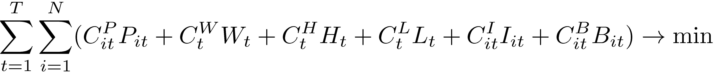
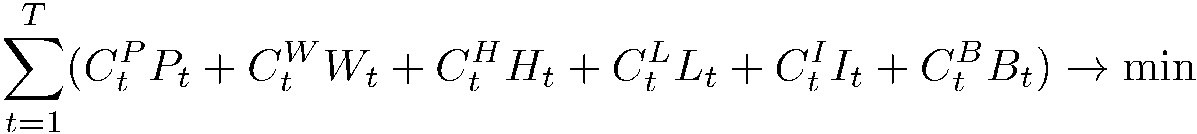
Extension 1: multiple products
objective function: minimize total costs
  personnel: wages + hiring + firing
  production
  inventory + backorders

Slide 7
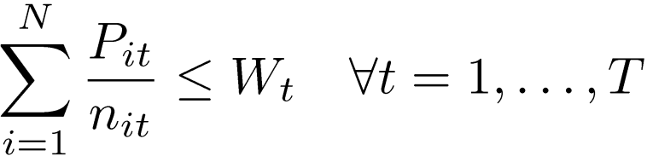
Extension 1: multiple products
constraints
  capacity
  inventory balance
  workforce balance
  non-negativity

Slide 8
Extension 1: multiple products
Computational Effort:
  number of decision variables: 3T + 3NT
  number of constraints: 2T + NT
    10 products, 12 periods:
      396 variables, 144 constraints

Slide 9
Example
Caroline Hardwood Product Mix
  produces 3 types of dining tables
  current workforce: 50 workers employed
    can be hired and laid off at any time
  initial inventory available
    100 units for table1
    120 units for table2 and 80 units for table 3
  N = 3
  W₀ = 50
  I₁₀ = 120
  I₂₀ = 100
  I₃₀ = 80
  T = 4
t | 1 | 2 | 3 | 4
Cost of hiring (C_{t}^{H}) | 420 | 410 | 420 | 405
Cost of layoff (C_{t}^{L}) | 800 | 790 | 790 | 800
Costs per worker (C_{t}^{W}) | 600 | 620 | 620 | 610

Slide 10
Example (cont.)
The number of units that can be made by one worker per period (n_{it})
forecasted demand (D_{it})
unit cost (C_{it}^{P}) and holding cost (C_{it}^{H}) per unit

Slide 11
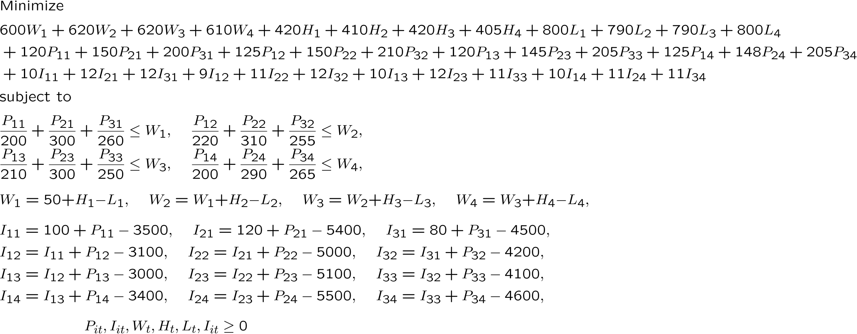

Example

Slide 12
Example
Solution: total costs $ 8354165.72
Workers | 1 | 2 | 3 | 4
Hired (Ht) | 1.60 | 0.00 | 0.00 | 5.64
Laid Off (Lt) | 0.00 | 3.91 | 0.00 | 0.00
Workers (Wt) | 51.60 | 47.69 | 47.69 | 53.32
Production (Pit) | 1 | 2 | 3 | 4
Table 1 (i=1) | 3400.00 | 3100.00 | 3000.00 | 3400.00
Table 2 (i=2) | 5280.00 | 5000.00 | 5100.00 | 5500.00
Table 3 (i=3) | 4420.00 | 4200.00 | 4100.00 | 4600.00
Inventory (Iit) | 1 | 2 | 3 | 4
Table 1 (i=1) | 0.00 | 0.00 | 0.00 | 0.00
Table 2 (i=2) | 0.00 | 0.00 | 0.00 | 0.00
Table 3 (i=3) | 0.00 | 0.00 | 0.00 | 0.00

Slide 13
Extension 2: Multiple Processes
multiple products
  each of which may be manufactured in a different way
  different processes (with zero setup times)
    possibly at different locations
    m_{i} ways to produce product i
  different resources
    workers, machines, departement
    making one unit of product i using process j
    requires a_{ijk} units of resource k

Slide 14
Extension 2: Multiple Processes
Parameters
  T length of planning horizon
  N number of products
  K number of resource types
  t Index of periods t = 1,2,…, T
  i Index of products i = 1,2,…,N
  k Index of resource types k = 1,…,K
  m_{i} number of different processes available for making i

Slide 15
Extension 2: Multiple Processes
Parameters (cont.)
  D_{it} forecasted demand of product i in period t (in units)
  A_{kt} amount of resource k available in period t
  a_{ijk} amount of resource k required to produce one unit of product i if produced by process j
  C_{it}^{P} costs to produce one unit of product i in t
  C_{it}^{I} inventory holding costs in t
  (per unit of product i and period)

Slide 16
Extension 2: Multiple Processes
decision variables
  P_{ijt} number of units of product i produced by process j in period t
  I_{it} number of units of product i held in stock at end of period t

Slide 17
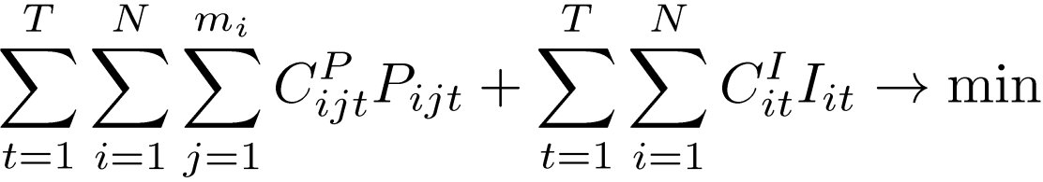
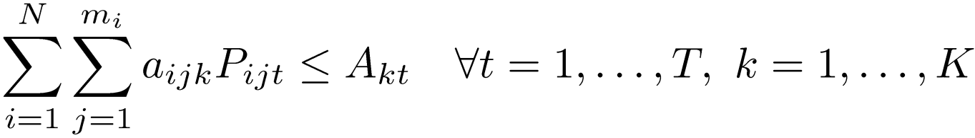
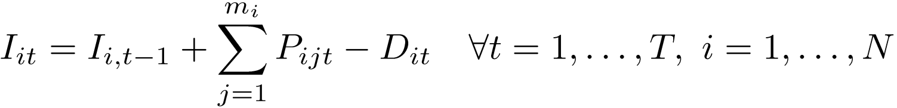
Extension 2: Multiple Processes
objective
capacity restriction
inventory balance
non-negativity

Slide 18
Example
Cactus Cycles
    2 types of bicycles, street and road N = 2
    plan production for next 3 months T = 3
    two resources (worker + machines) K = 2
    two different processes m_{i} = 2
    estimated demand and current inventory: D_{it} / I_{i0}

Slide 19
Example (cont.)
    available capacity A_{kt} (hours) and holding costs per bike I_{it}
process costs (P_{ijt}) and resource requirement (a_{ijk}) per unit

Slide 20
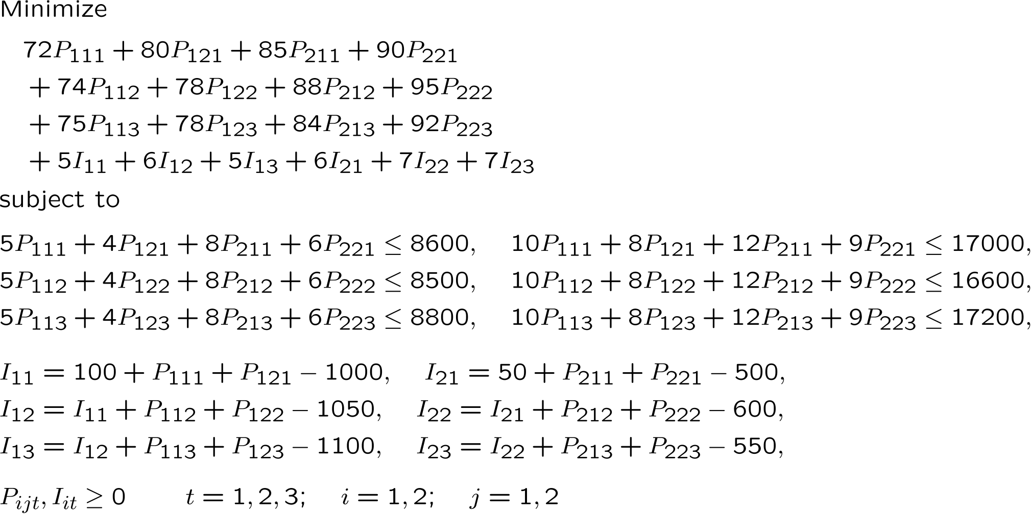
Example

Slide 21
Example
Solution
  objective (min costs) $ 368756.25
 | Produce (Pi1t) |  |  |  | Produce (Pi2t)
 | 1 | 2 | 3 |  | 1 | 2 | 3
Street (i=1) | 900.00 | 1050.00 | 0.00 |  | 0.00 | 0.00 | 1100.00
Road (i=2) | 118.75 | 406.25 | 550.00 |  | 525.00 | 0.00 | 0.00
Inventory (Iit) | 1 | 2 | 3
Street (i=1) | 0.00 | 0.00 | 0.00
Road (i=2) | 193.75 | 0.00 | 0.00

Slide 22
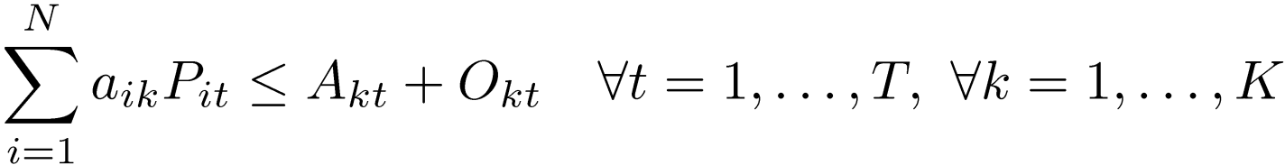
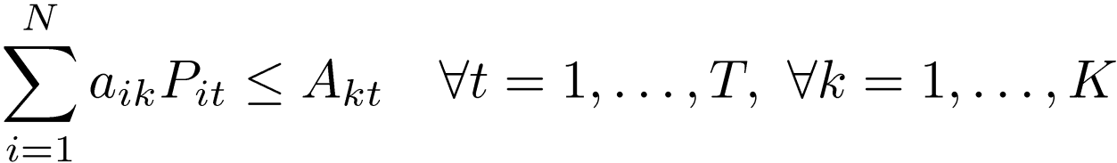
Extension 3: Overtime
Overtime
  so far: workstation k in time t available for fixed amount of time A_{kt}
    might be increased at additional costs C^{O}_{t}
    capacity limited O_{kt}^{max}
  introduce new decision variable O_{kt}
  modify capacity restriction
  limit its availability

Slide 23
Extension 4: Yield Loss
Yield Loss
  products may be scrapped at various points in the production line (quality problems)
  release additional material to compensate for loss
  upstream workstations more heavily utilized

Slide 24
Extension 4: Yield Loss
Concept
  ®, ¯, ° fraction of output that is lost
  desired output for product i from C d
  cumulative yield from station k onward (including station k) y_{ik}
  release d / y_{ik} units of product i into station k
A
B
C

Slide 25
Extension 4: Yield Loss
Example
  ® = 10%, ¯ = 3%, ° = 5´%
  desired output from C 100
  cumulative yields release
    y_{1C} = (1 – 0.05) = 95% 100 / 0.95 = 105.26
    y_{1B} = (1 – 0.05)(1 – 0.03) = 92.15% 100 / 0.92 = 108.69
    y_{1A} = (1 – 0.05)(1 – 0.04)(1 – 0.1) = 82.935% 100 / 0.83 = 120.5
A
B
C

Slide 26
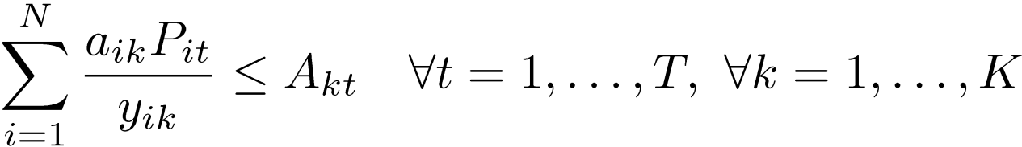
Extension 4: Yield Loss
LP Formulation

